Slide 1

Transaction Fraud & Anomaly Analysis Dashboard
Patterns and Risk Indicators
Eveline Wasonga

Slide 2

CONTENT
01
02
Transaction Analysis Overview
Merchant and Client Insights
03
Geographic Transaction Patterns

Slide 3


01
Transaction Analysis Overview

Slide 4







Summary
Statistical Overview
Transaction Types
Common Errors
Fraud Indicators
Mean 43.77, standard deviation 85.33, minimum -500, maximum 6,820.20.
Swipe transactions dominate with 934,123 (89.1%) versus 114,249 online transactions (10.9%).
Insufficient balance leads errors with 852 occurrences, followed by bad card numbers at 561.
Multiple failed attempts before success flag potential fraud activity across high-volume clients.

Slide 5
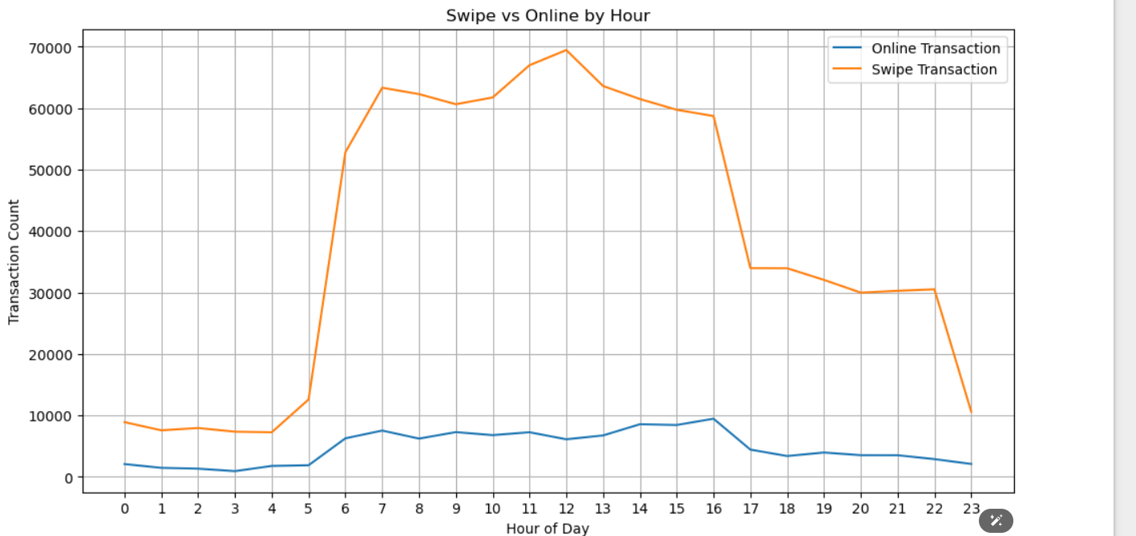
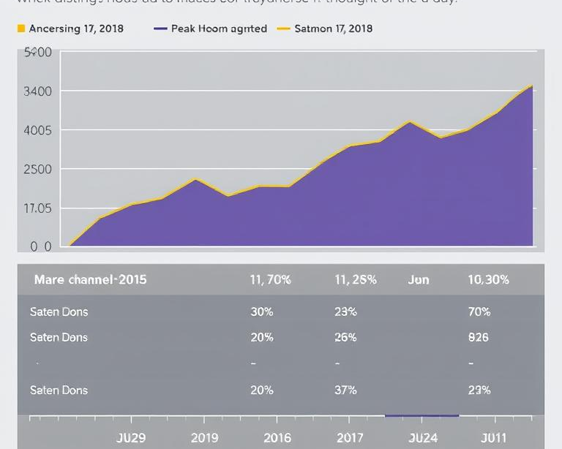


Swipe vs Online transactions
Channel Distribution Patterns
Hourly Transaction Rhythm
Fraud Risk Indicators
Channel Security Implications
Swipe dominates daytime, online increases during late-night hours.
Peak activity during business hours, with distinct channel preferences throughout the day.
Nighttime online spikes may indicate card testing, credential stuffing, or automated fraud attempts.
Different risk profiles between physical and digital transactions require tailored monitoring strategies.

Slide 6

Error types distribution
Most Common Errors
Technical Issues
Insufficient Balance leads with 852 cases, followed by Bad Card Number at 561.
Technical Glitch accounts for 245 errors, while combined errors appear in minimal numbers.
Error Patterns
Fraud Indicators
Single errors dominate, with combined errors representing less than 1% of total issues.
Multiple failed attempts before success flag potential fraud activity across transactions.

Slide 7





Fraud flag indicators
Multiple Failed Attempts
Unusual State Activity
Clients with high transaction failures show potential fraud patterns requiring immediate investigation.
Same client transactions in different states within minutes indicates suspicious geographic movement patterns.
Merchant Decline Rates
Nighttime Online Spikes
Merchants with high decline percentages may be processing fraudulent transactions or experiencing technical issues.
Increased online activity during late hours suggests potential automated fraud attempts or card testing.

Slide 8
02
Merchant and Client Insights

Slide 9
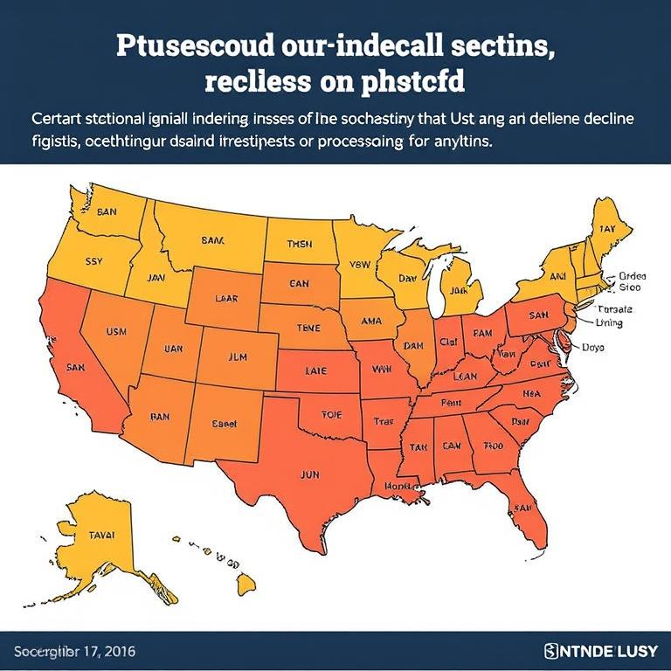
High decline merchants
Common Decline Reasons
Merchant_ID Decline Count
27092 1471
59935 880
61195 672
39021 582
43293 493
60569 487
22204 469
26810 287
50783 269
20561 249
Top Decline Merchants
Five merchants show unusually high decline rates, indicating potential fraud or technical issues.
Insufficient balance and bad card numbers represent majority of merchant declines across platform.
Geographic Patterns
Merchant ID 27092
Highest decline count at 1,471 transactions, significantly above average and requiring immediate investigation.
Certain states show concentrated decline activity, suggesting regional fraud attempts or processing issues.

Slide 10


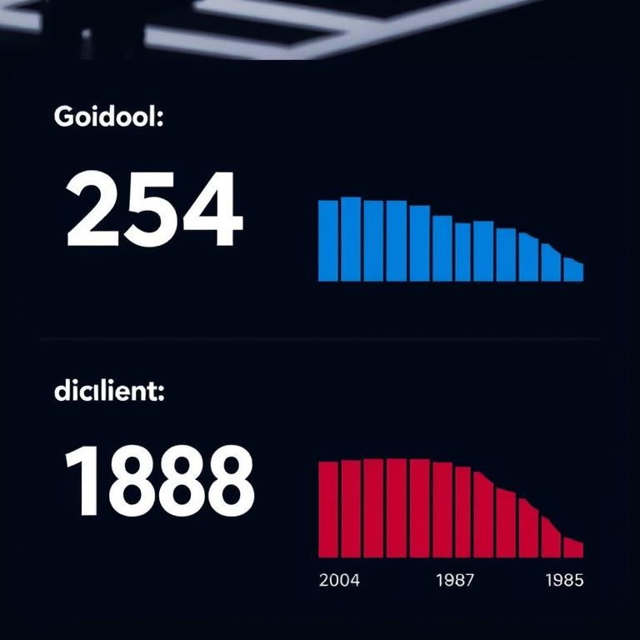
Frequent decline clients
Top Decline Clients
Insufficient Balance Issues
Client 954 leads with 240 declines, followed by client 1888 with 159 declines.
Frequent insufficient balance errors indicate potential cash flow problems or fraud attempts.
02
01
03
Monitoring Recommendations
04
Fraud Indicators
Implement enhanced verification for high-decline clients and establish automated monitoring systems.
Multiple failed attempts before success flag potential fraudulent activity requiring investigation.

Slide 11
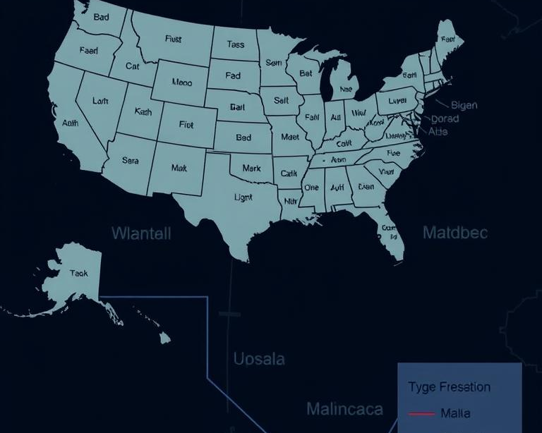
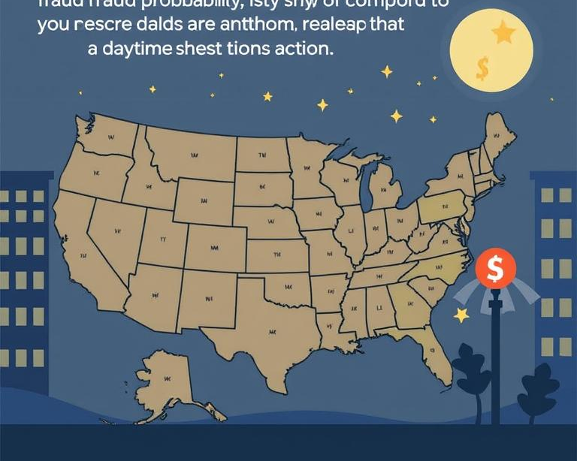

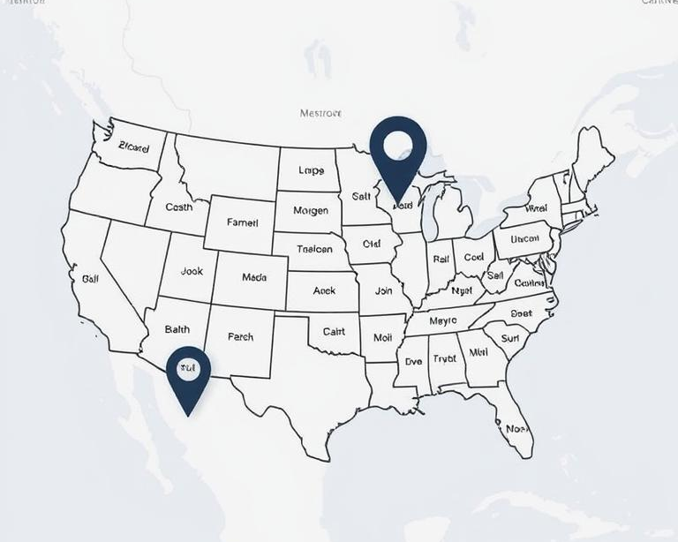
Cross-state spending patterns
Rapid State Transitions
High-Risk Time Windows
Geographic Anomalies
Velocity Monitoring
Transactions in different states within minutes indicate potential fraud patterns requiring investigation.
Late-night cross-state activities show higher fraud probability compared to daytime transactions.
Unusual state combinations like ME-NV within minutes flag suspicious cardholder behavior.
Implementing geo-velocity checks can prevent fraudulent cross-state transaction attempts.

Slide 12
Transaction volume by hour
Swipe vs Online Patterns
Channel Distribution
Swipe transactions dominate daytime, while online activity increases during late-night hours.
Swipe transactions consistently represent 80-90% of hourly volume across most time periods.
Peak Hours
Fraud Indicators
Highest transaction volumes occur between 9am-5pm, with notable decline after business hours.
Nighttime online spikes may indicate card testing, credential stuffing or automated fraud attempts.

Slide 13
03
Geographic Transaction Patterns

Slide 14
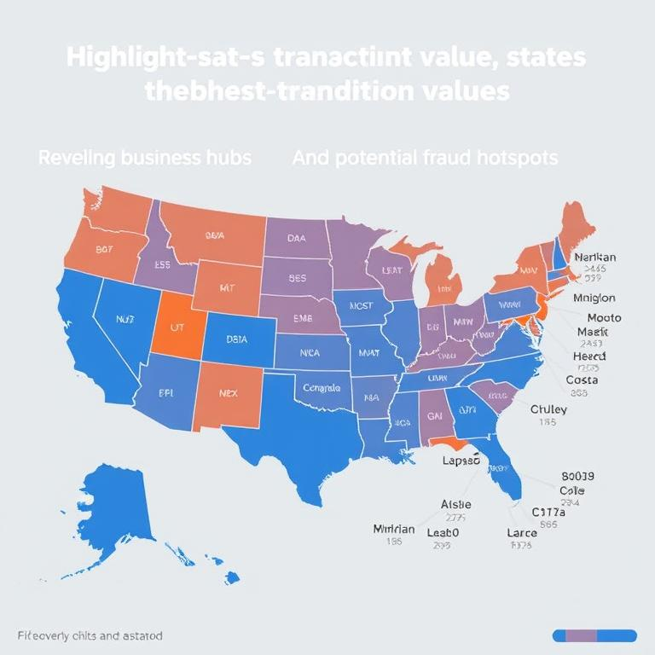
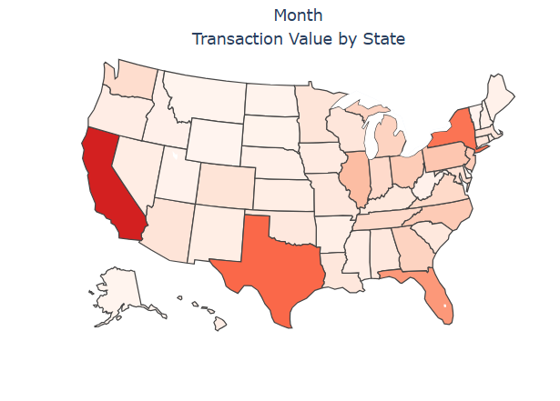

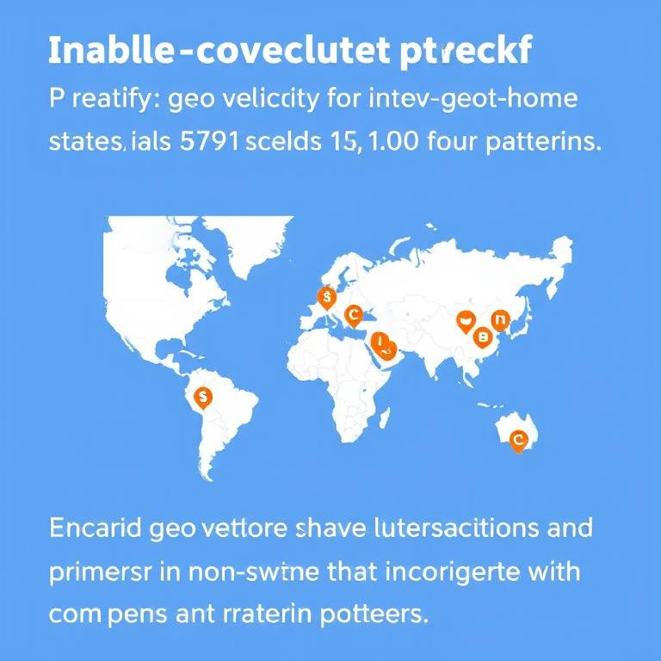
Transaction value by state
1
2
3
4
Geographic Value Distribution
Regional Risk Assessment
Value Concentration Patterns
State-Level Monitoring
Highlights states with highest transaction values, revealing business hubs and potential fraud hotspots.
Identifies unusual activity in unexpected states that may signal cloned cards or merchant fraud.
Shows where customer spending clusters geographically, helping target investigations of suspicious regional spikes.
Enables geo-velocity checks to flag transactions occurring in non-home states that conflict with travel patterns.

Slide 15
High-risk ZIP codes
Top Refund Locations
Unknown ZIP Risk
ZIP codes with highest refund activity indicate potential fraud patterns requiring investigation.
Hot refund zips
Zip Refund Count
0<NA> 1457
98516 718
29229 570
43830 564
77056 526
91606 521
55024 517
94606 464
07922 456
96792 370
51023 368
89148 365
51022 349
87121 349
48146 348
80013 328
Missing ZIP data represents significant vulnerability with highest refund volume across all locations.
Geographic Hotspots
Monitoring Strategy
Clusters in specific regions suggest organized fraud networks or compromised merchant terminals.
Implement enhanced verification for high-risk ZIPs to reduce fraudulent transaction attempts.

Slide 16
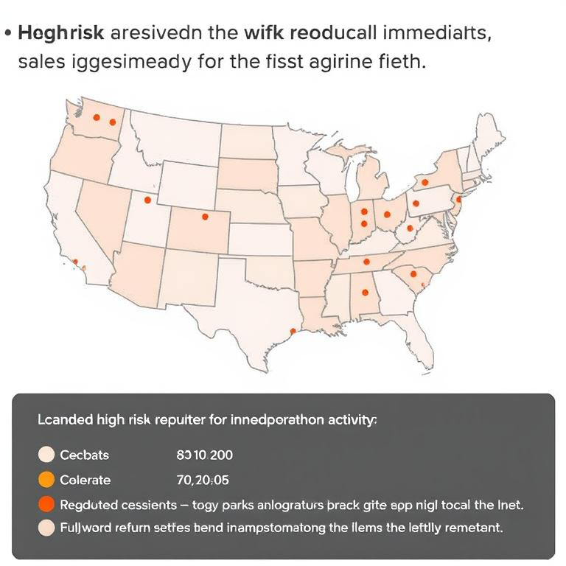
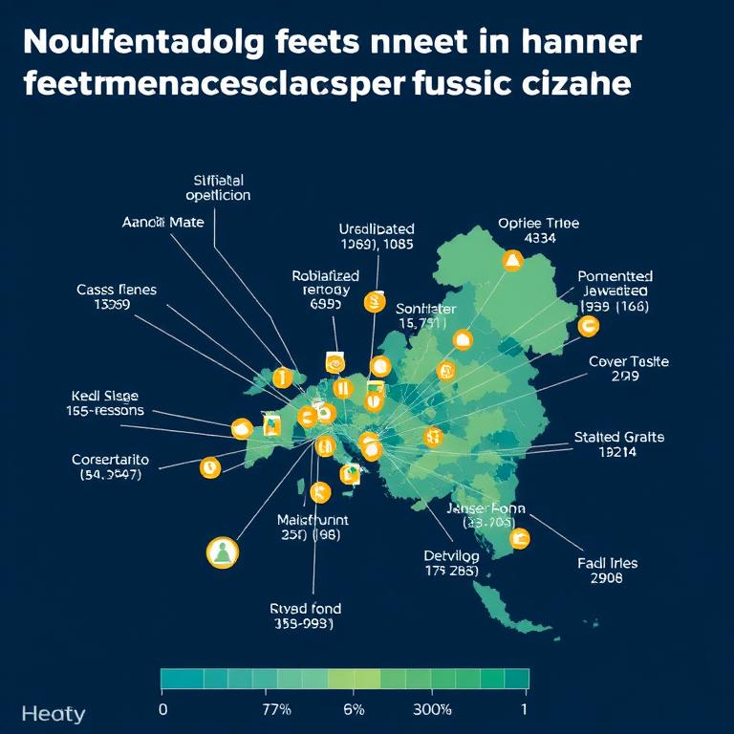
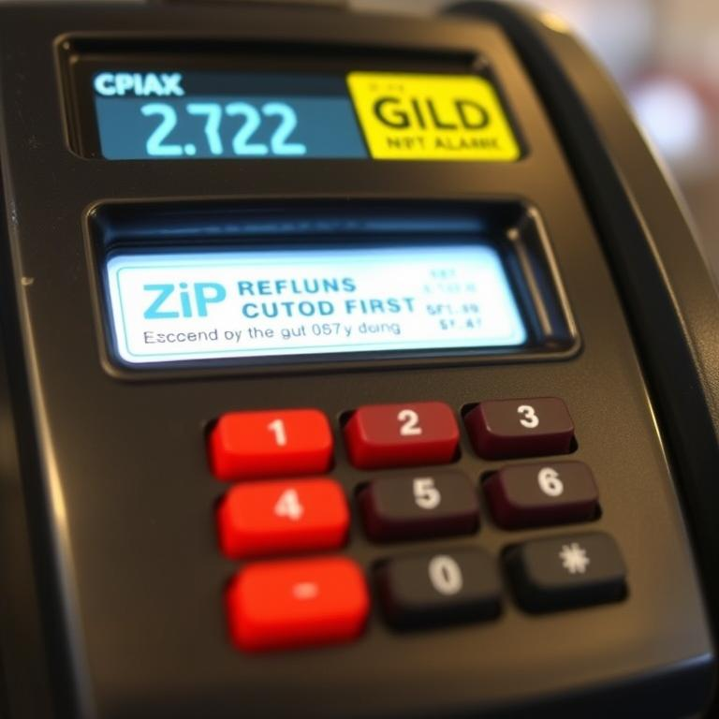
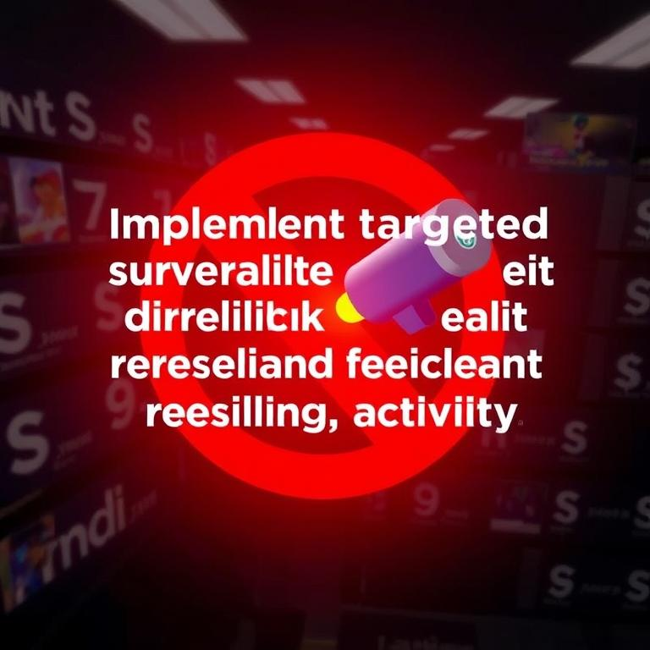
Refund hotspots
1
2
3
4
Top Refund ZIPs
Refund Patterns
Risk Indicators
Monitoring Strategy
Identified high-risk areas with unusual refund activity requiring immediate investigation.
Concentrated activity in specific locations suggests potential fraud schemes or merchant issues.
ZIP codes with excessive refunds may indicate organized fraud rings or compromised merchant terminals.
Implement targeted surveillance for high-risk ZIPs to detect and prevent fraudulent refund activity.

Slide 17
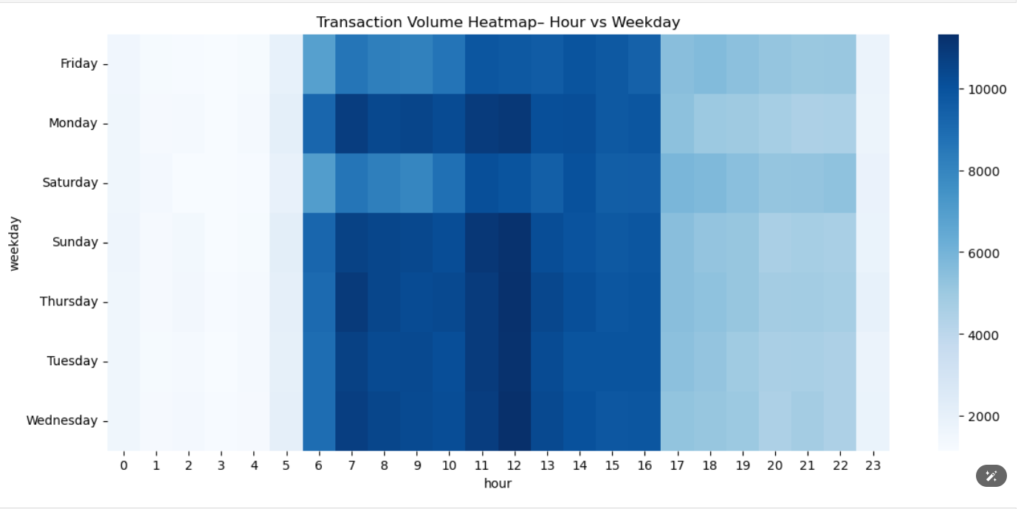
Channel distribution analysis
Swipe vs Online Transactions
Hourly Transaction Patterns
Swipe dominates with 934,123 transactions while online shows 114,249 transactions.
Swipe peaks during business hours while online shows increased activity during late-night hours.
Channel Fraud Indicators
Risk Management Strategy
Online spikes during off-hours may indicate card testing or compromised credentials.
Monitor channel migration and implement stronger verification for sudden online-only activity.

Slide 18
Thanks！

